Slide 1
Wavelet Spectral Analysis
Ken Nowak
7 December 2010

Slide 2
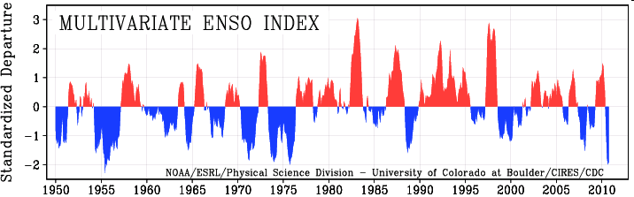
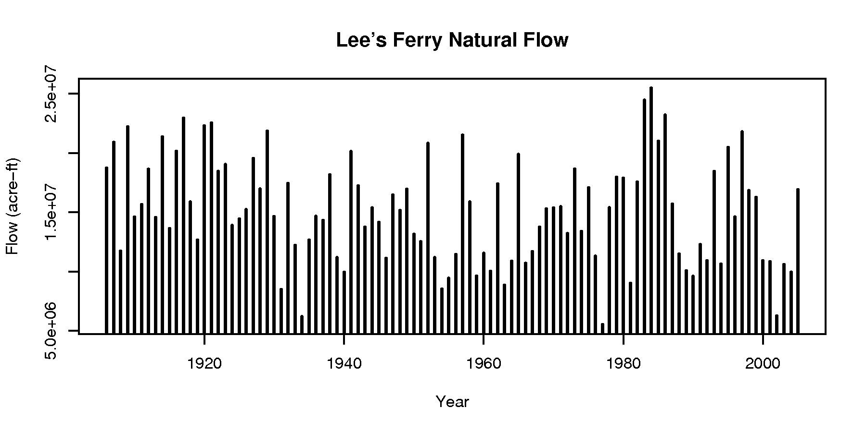
Need for spectral analysis
Many geo-physical data have quasi-periodic tendencies or underlying variability
Spectral methods aid in detection and attribution of signals in data

Slide 3
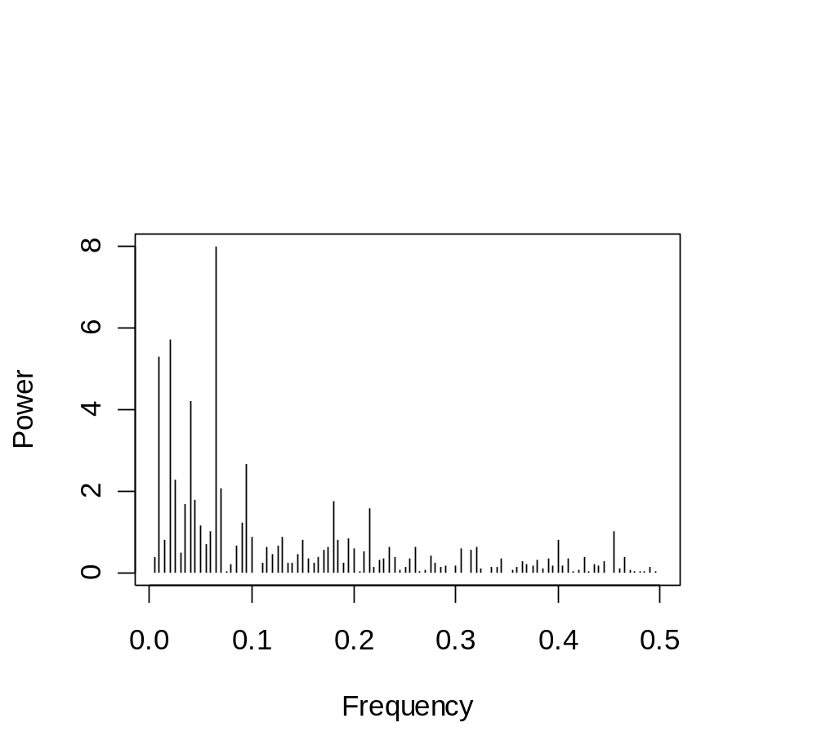
Fourier Approach Limitations
Results are limited to global
Scales are at specific, discrete intervals
  Per fourier theory, transformations at each scale are orthogonal

Slide 4
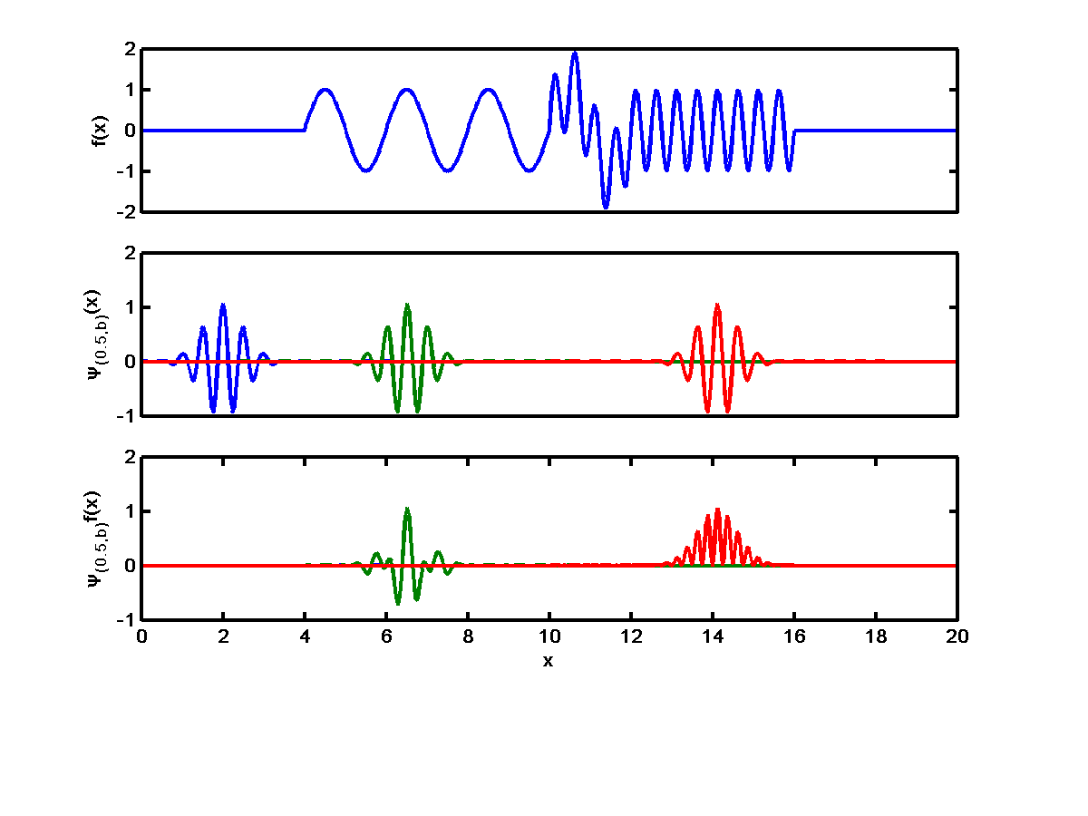
Wavelet Basics
∫
W_{f}(a,b)= f(x) ψ_{(a,b)} (x) dx
Function to analyze
Wavelets detect non-stationary spectral components
⌡
Morlet wavelet with a=0.5
b=2
b=6.5
b=14.1
Integrand of wavelet transform
|W(a=0.5,b=6.5)|²=0
|W(a=0.5,b=14.1)|²=.44
graphics courtesy of Matt Dillin
Notes:
Function at the top is a signal with varying dominant scales in space.
The middle shows a wavelet kernel (morlet) that is scaled by the a-parameter=1/2 and shifted by the b-parameter across the domain of the signal. Since the kernel only exists in a finite space it will only analyze the subsets of the data where the kernel is not zero. This allows for spatial descritization.
The bottom shows the wavelet spectrum has large values where the scaling parameter a matches the signal (b=14.1) and small values where the scaling parameter doesn’t match the signal well (b=2, 6.5). This procedure is repeated for all scales within the range of the signal across all positions.

Slide 5
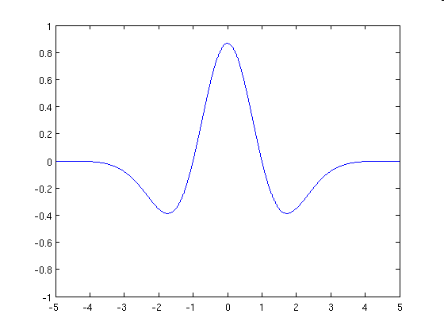
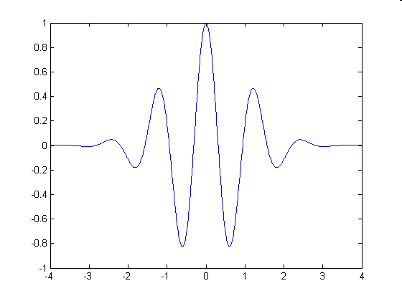
Wavelet Basics
Here we explore the Continuous Wavelet Transform (CWT)
  No longer restricted to discrete scales
  Ability to see “local” features
Mexican hat wavelet Morlet wavelet
Notes:
Mean zero and localized in both time and frequency space

Slide 6
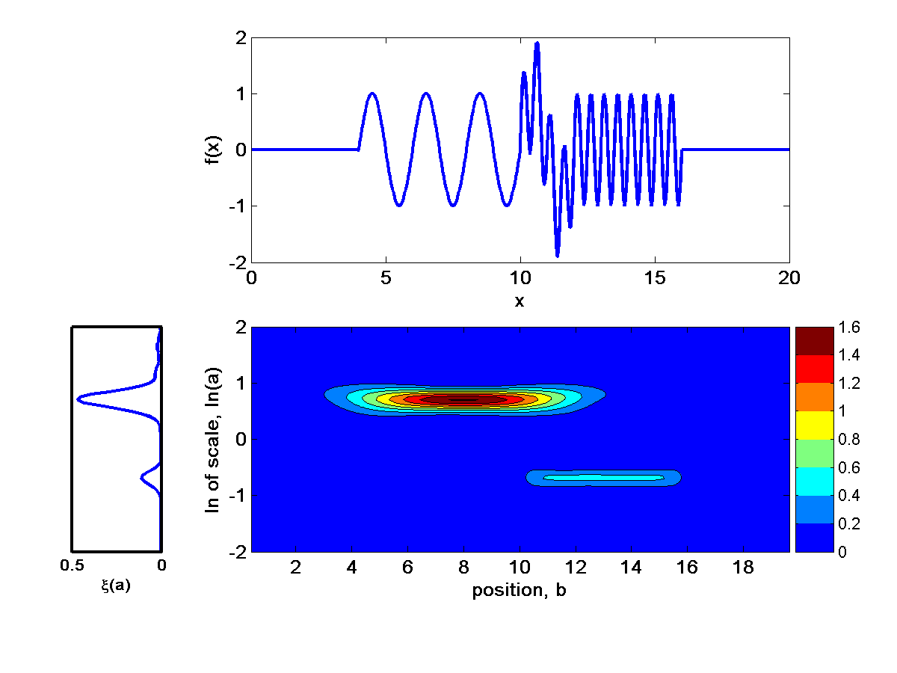
Global Wavelet Spectrum
function
Global
wavelet
spectrum
Wavelet
spectrum
a=2
|W_{f} (a,b)|²
a=1/2
Slide courtesy of Matt Dillin
Notes:
Wavelet spectrum is square of real component of wavelet transform. Global is average across the scales.

Slide 7
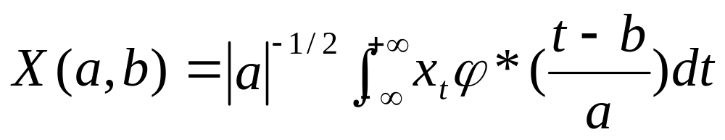
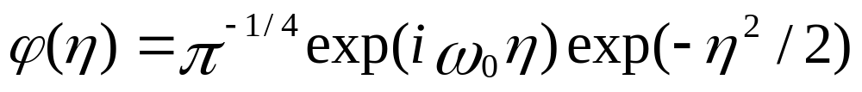
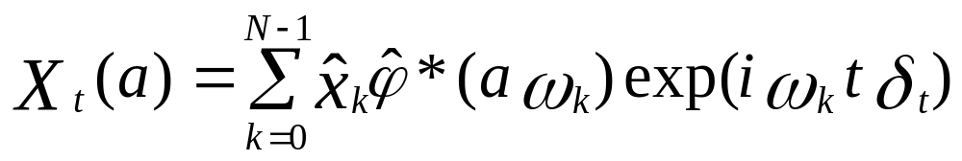
Wavelet Details
Convolutions between wavelet and data can be computed simultaneously via convolution theorem.
Wavelet transform
Wavelet function
All convolutions at scale “a”
Notes:
where a is a scale parameter, b is the shift parameter and phi is the wavelet function, * denotes complex, w and n are frequency and time (space) parameters for wavelet. Point wise convolutions are accomplished simultaneously via multiplication in the fourier domain and back transformation with inverse fourier transform (exp portion of equation)

Slide 8
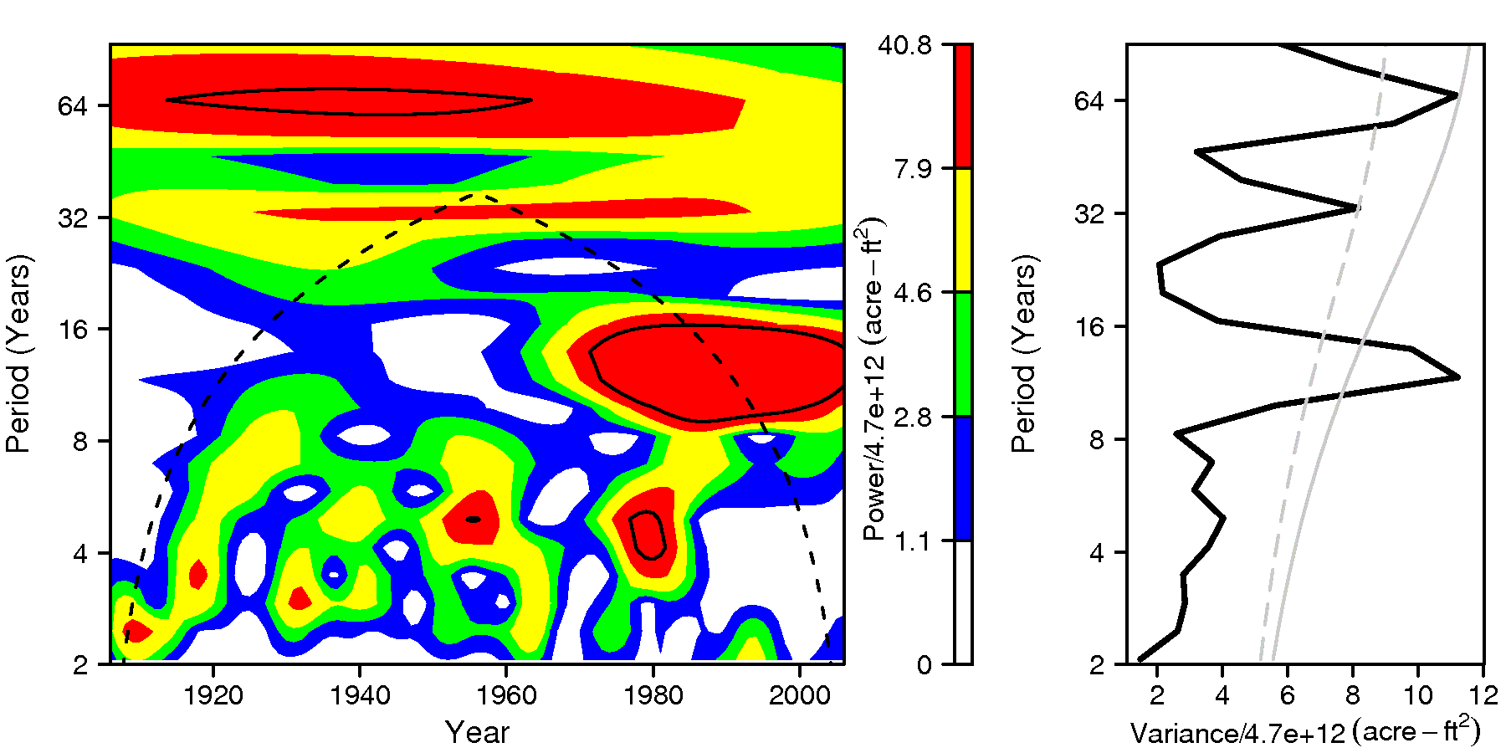
Analysis of Lee’s Ferry Data
Local and global wavelet spectra
Cone of influence
Significance levels

Slide 9
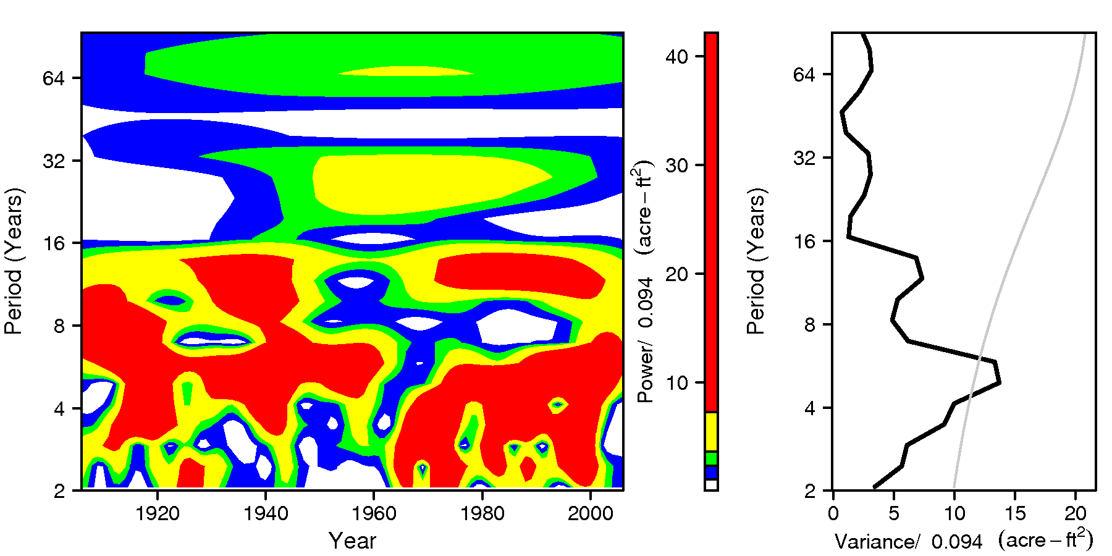
Analysis of ENSO Data
Characteristic ENSO timescale
Global peak

Slide 10
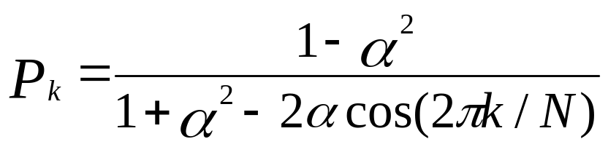
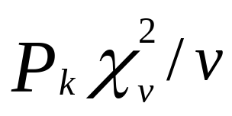
Significance Levels
Background Fourier spectrum for red noise process (normalized)
Square of normal distribution is chi-square distribution, thus the 95% confidence level is given by:
Where the 95th percentile of a chi-square distribution is normalized by the degrees of freedom.
Notes:
k= frequency index, N is length of data and alpha is AR coeff. If alpha = 0, then white noise background – chi square with v degrees of freedom

Slide 11
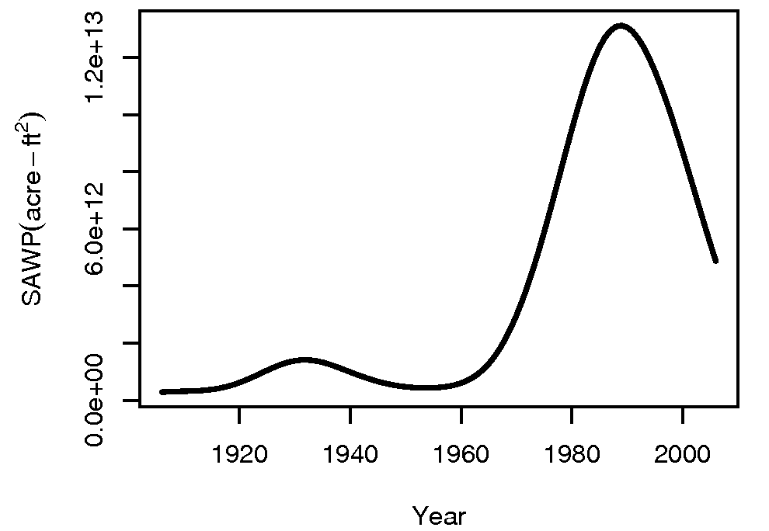
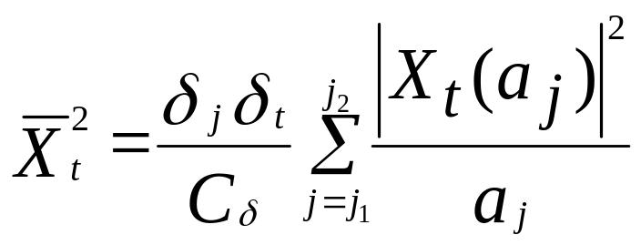
Scale-Averaged Wavelet Power
SAWP creates a time series that reflects variability strength over time for a single or band of scales
Notes:
C is empirically derived value specific to wavelet function and deltas are delta time and scale coefficient

Slide 12
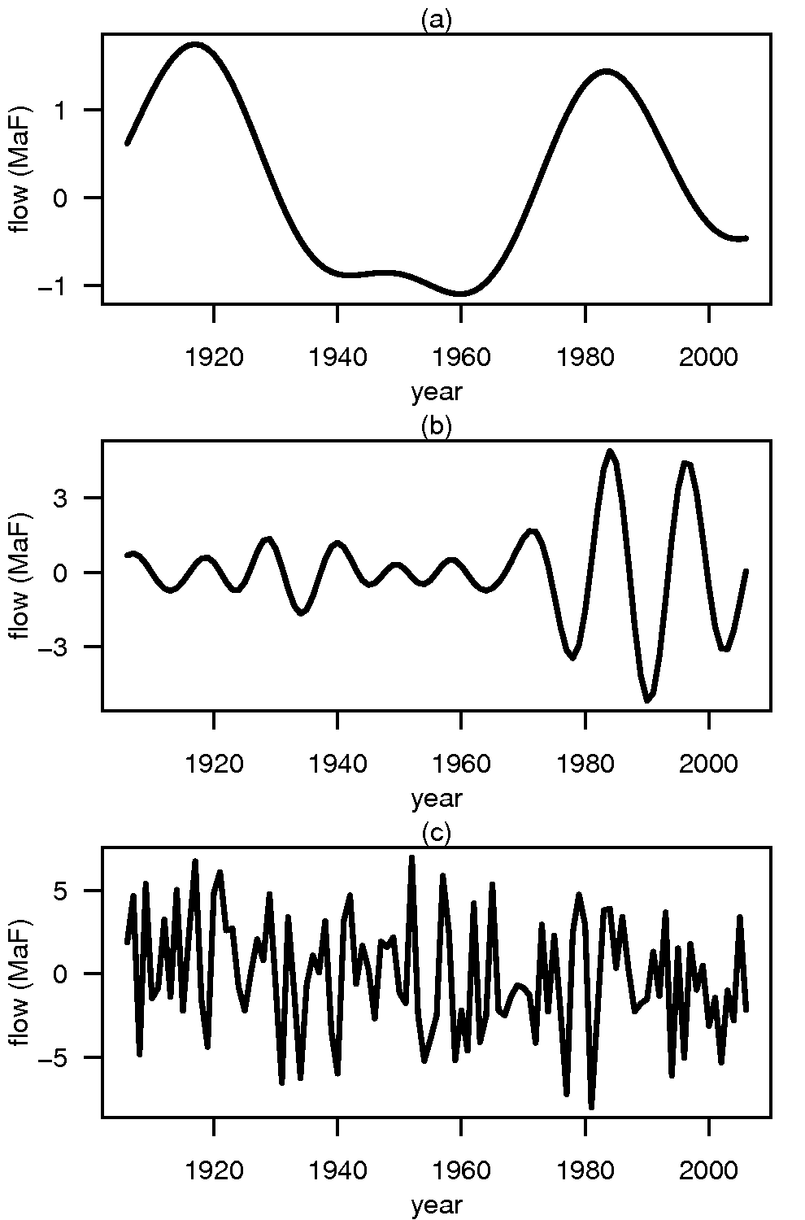
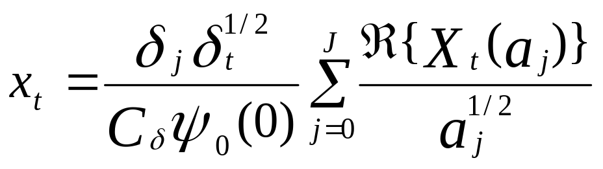
Band Reconstructions
We can also reconstruct all or part of the original data
Notes:
J is range of scales over which to reconstruct C and psi are empirically derived wavelet values

Slide 13
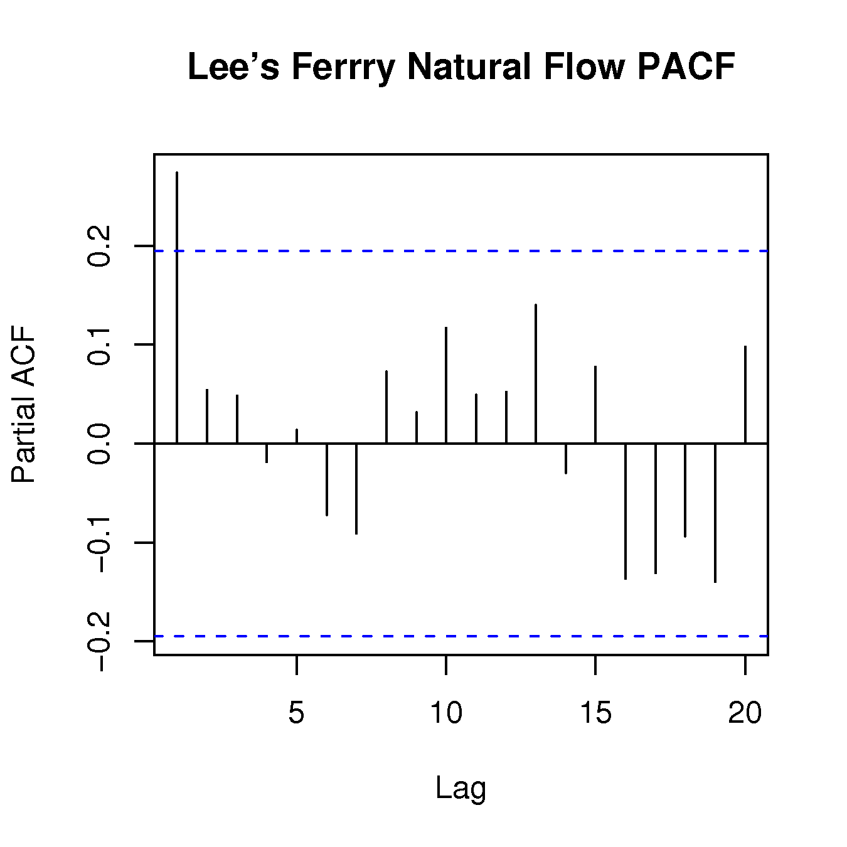
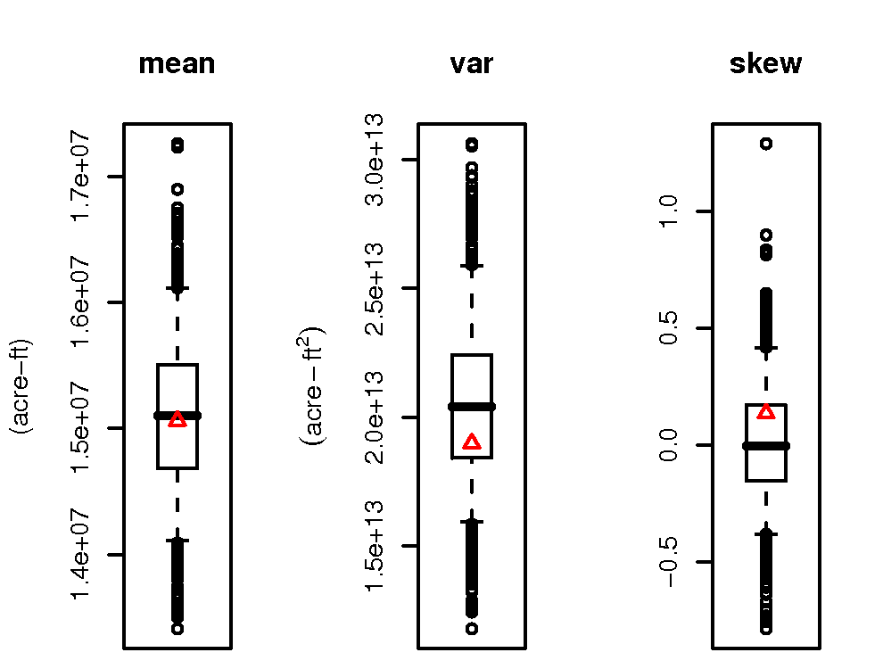
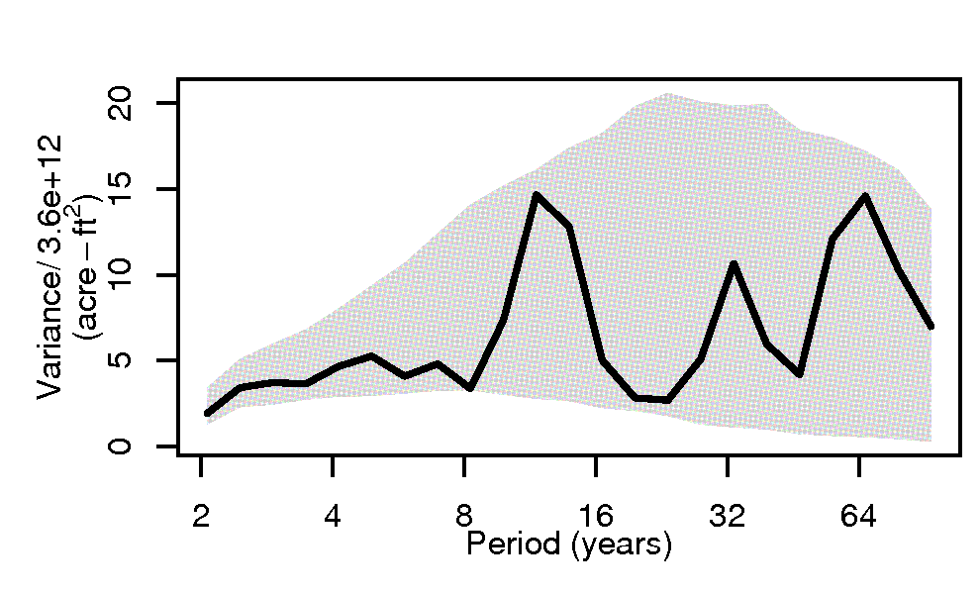
Lee’s Ferry Flow Simulation
PACF indicates AR-1 model
Statistics capture observed values adequately
Spectral range does not reflect observed spectrum
Notes:
Similar spectral results for K-NN

Slide 14
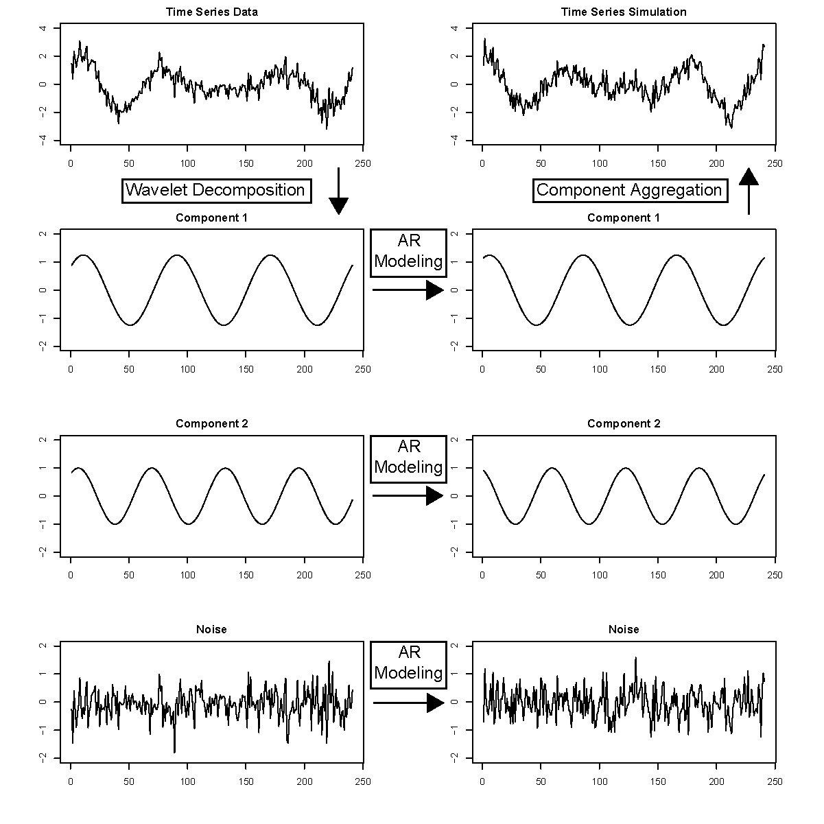
Wavelet Auto Regressive Method (WARM) Kwon et al., 2007

Slide 15
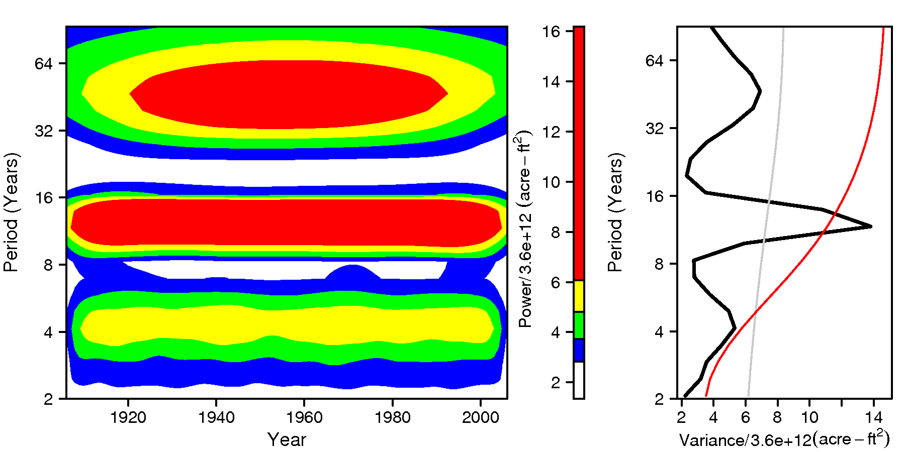
WARM and Non-stationary Spectra
Power is smoothed across time domain instead of being concentrated in recent decades

Slide 16
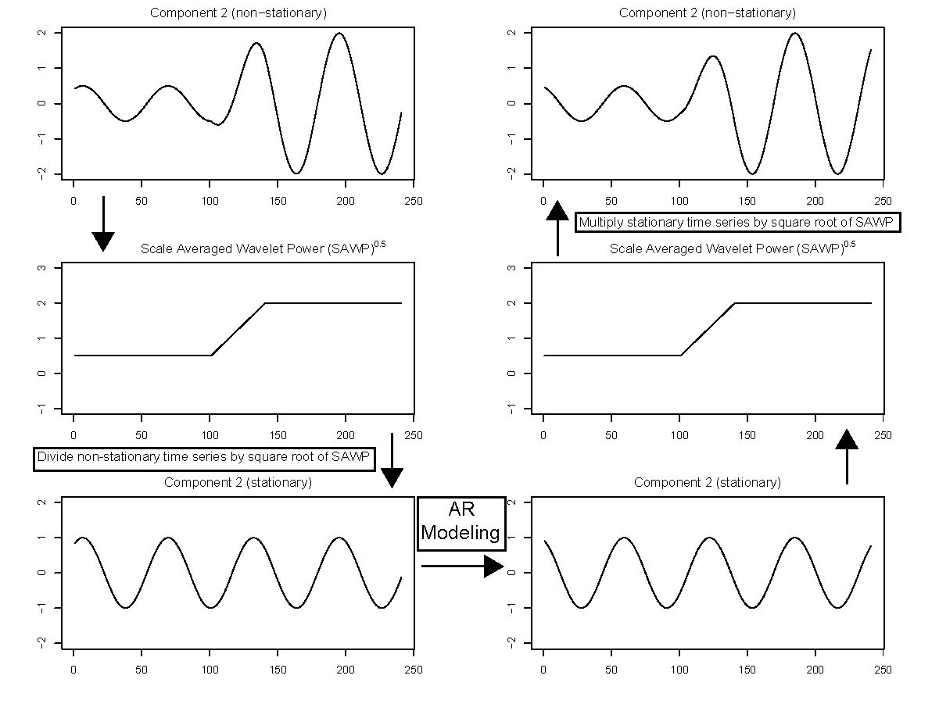
WARM for Non-stationary Spectra

Slide 17
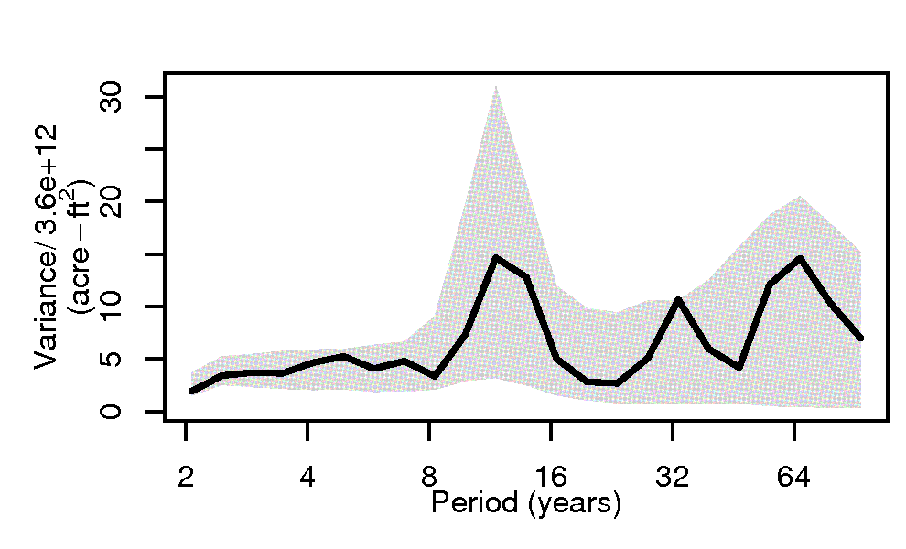
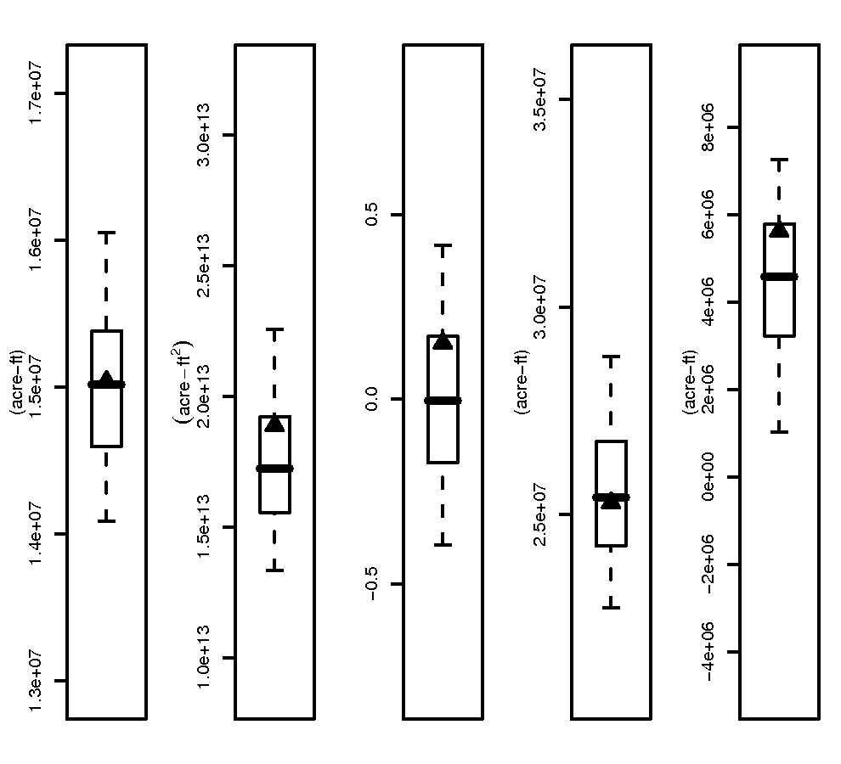
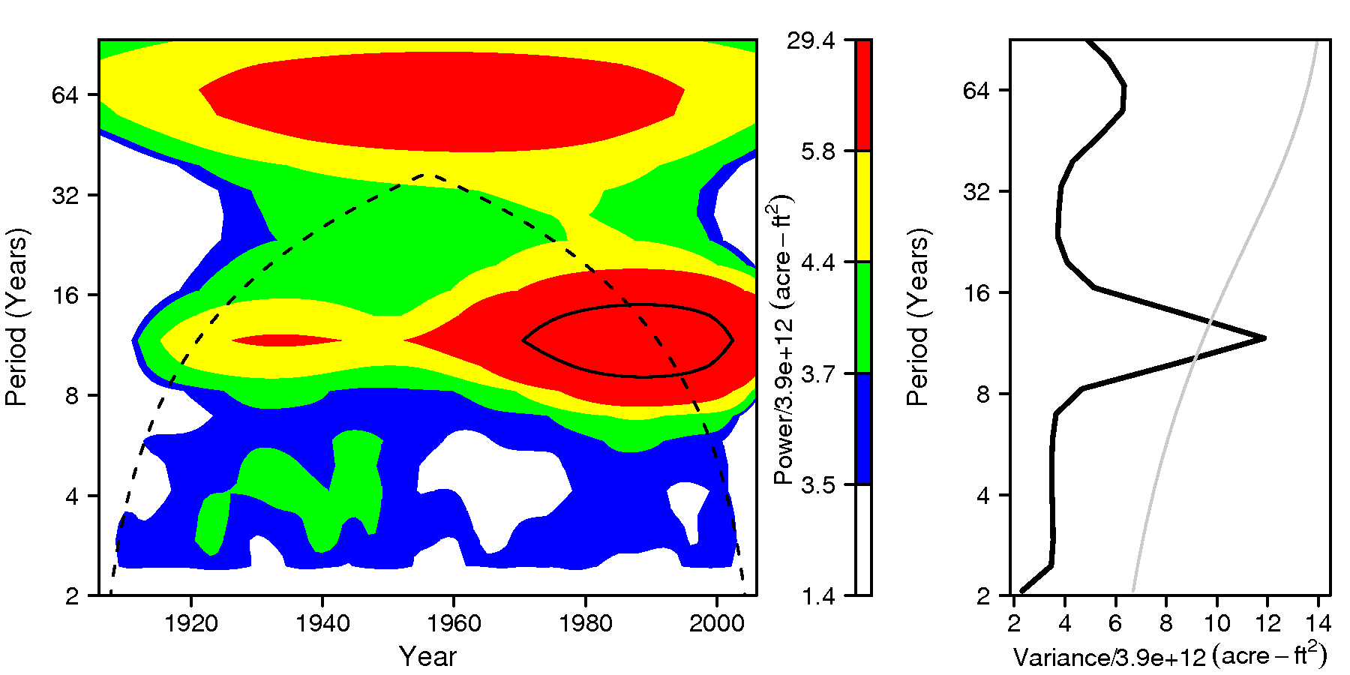
Results for Improved WARM

Slide 18
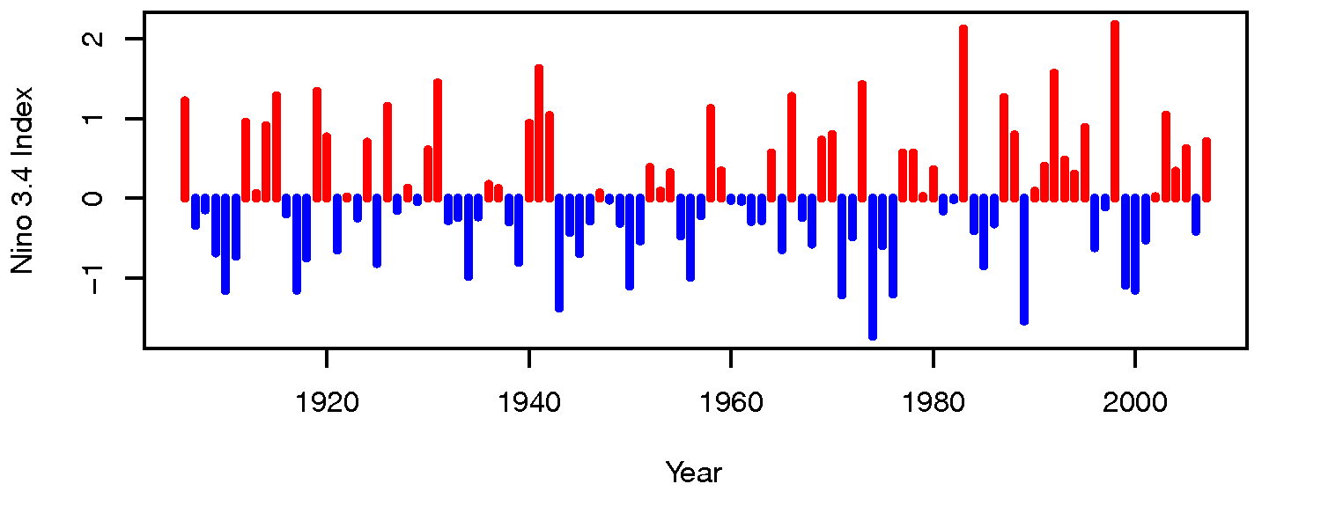
Wavelet Phase and Coherence
Analysis of relationship between two data sets at range of scales and through time
Correlation = .06

Slide 19
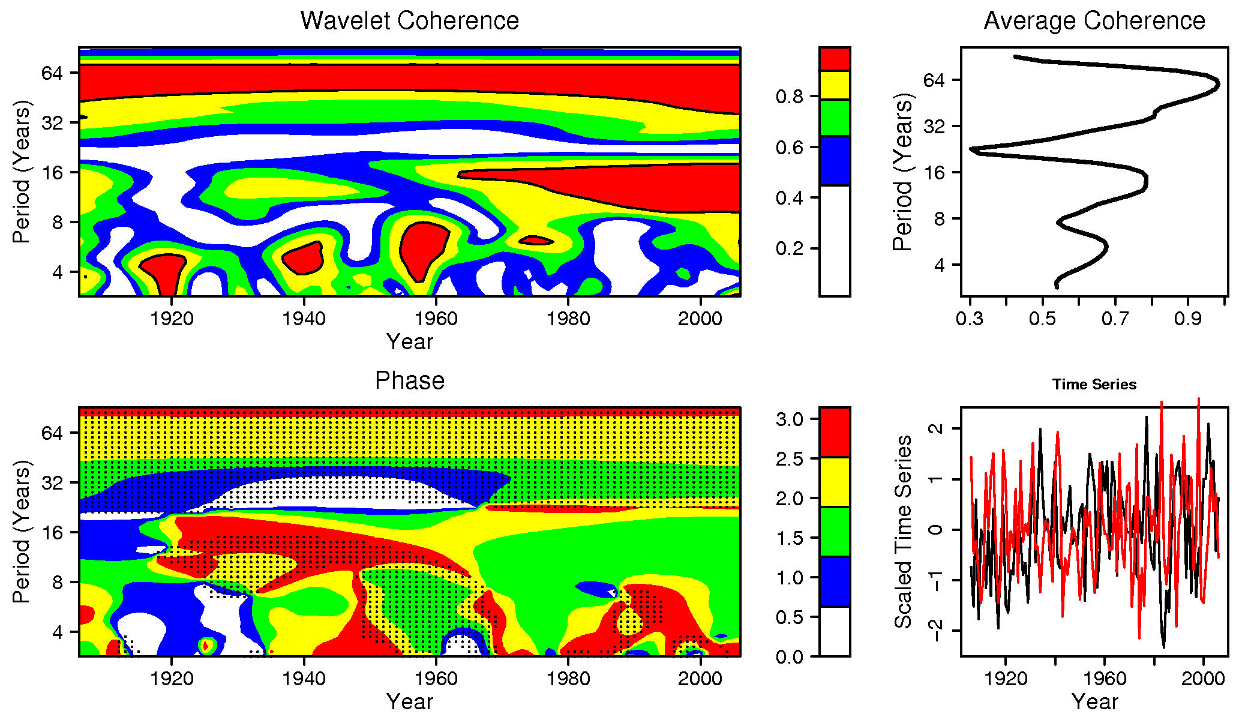
Wavelet Phase and Coherence

Slide 20
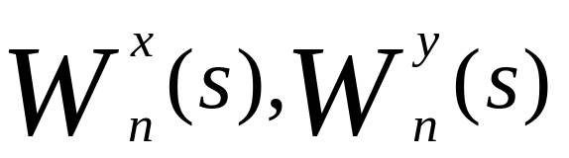
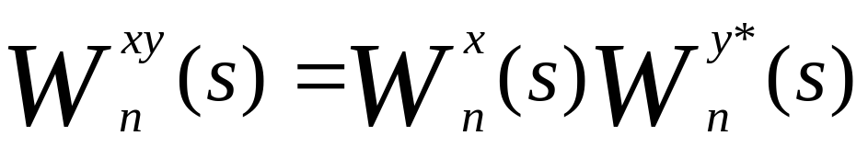
Cross Wavelet Transform
For some data X and some data Y, wavelet transforms are given as:
Thus the cross wavelet transform is defined as:
Notes:
* Denotes complex conjugate

Slide 21
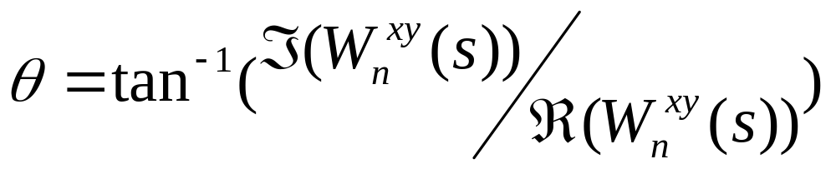
Phase Angle
Cross wavelet transform (XWT) is complex.
Phase angle between data X and data Y is simply the angle between the real and imaginary components of the XWT:

Slide 22
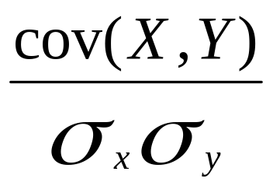
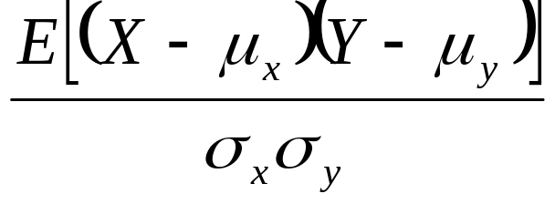
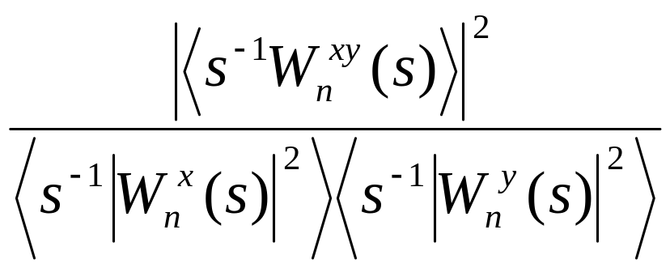
Coherence and Correlation
Correlation of X and Y is given as:
Which is similar to the coherence equation:
Notes:
Instead of top term being “average” across 2 time series, values from square of XWT are “point values” thus we need to smooth over some range in time and frequency to see how 2 data sets relate “locally” also, wavelet transforms must be normalized by scale.

Slide 23
Summary
Wavelets offer frequency-time localization of spectral power
SAWP visualizes how power changes for a given scale or band as a time series
“Band pass” reconstructions can be performed from the wavelet transform
WARM is an attractive simulation method that captures spectral features

Slide 24
Summary
Cross wavelet transform can offer phase and coherence between data sets
Additional Resources:
http://paos.colorado.edu/research/wavelets/
http://animas.colorado.edu/~nowakkc/wave

Slide 25
